Slide 1

eBook-Library
MSc-Software Systems
Vignesh G-1831056

Slide 2
Problem Objective
This project is aimed at the development of a application used to read eBooks from an eBook-library with various functionalities provided for the user.
Provides flexibility to user to navigate through the e-books
eBooks can also be opened from Local Machine

Slide 3
Problem Scope
This Application allows the user to choose and read from hundreds of eBooks present in the E-Library and also provides a User friendly e-book reader to read the eBooks.
The E-Library is updated frequently to provide the readers with the latest reads.

Slide 4
Problem Solution
Graphical User Interface: GUI is used in several parts such as administrator/customer login and eBook library. JAVA swings and AWT is used for designing the user interface of the eBook Reader and eBook Library.
Database Management :Oracle Database is used to hold the details of reader, eBook library and books.

Slide 5
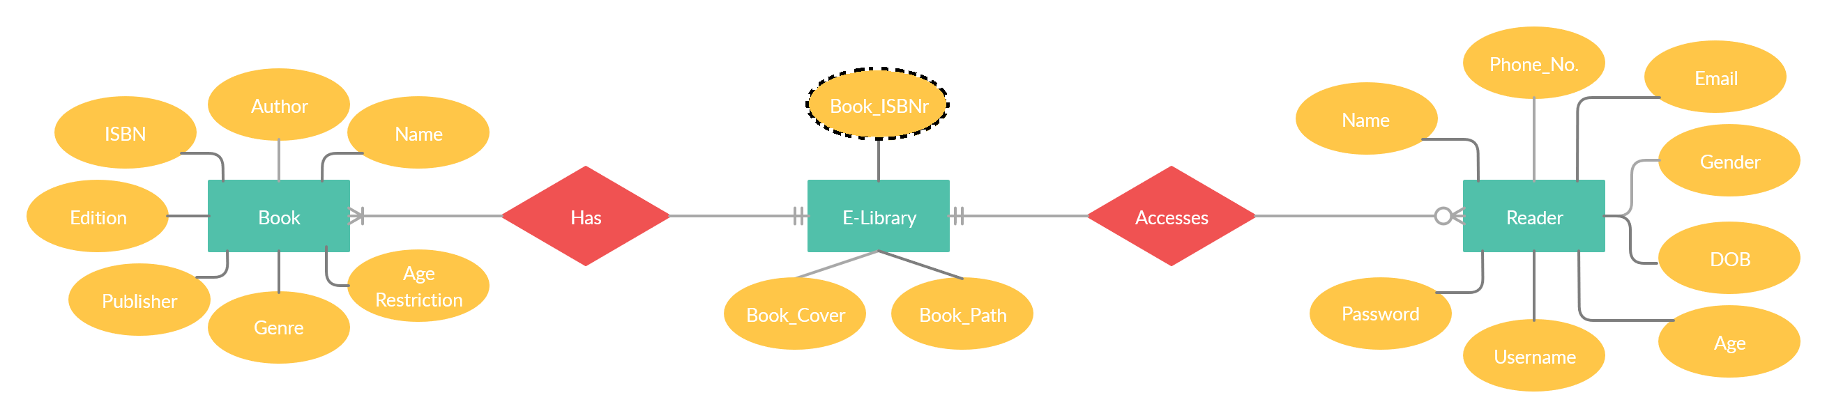
ER Diagram

Slide 6
Functionalities
Administrator
Add new books to eBook Library
Delete Books in eBook Library
View Reader/Book/Log Records
Customer
Read eBooks from eBook Library
Read Book from Local Machine
Change password/Username

Slide 7
Additional Features
Administrator Module and Forgot Password Module requires OTP (Sent to the respective users email).
Reader’s User interface is in Dark Theme.
Settings Module is provide for customization of E-Book reader and for changing Username/Password of User.
E-Library will show books based on reader’s age.

Slide 8
Front-end Design

Slide 9
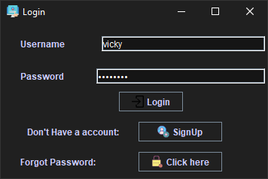
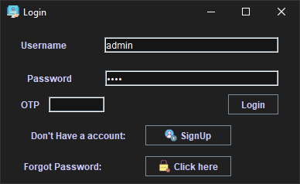
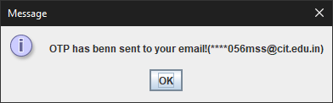
Login

Slide 10
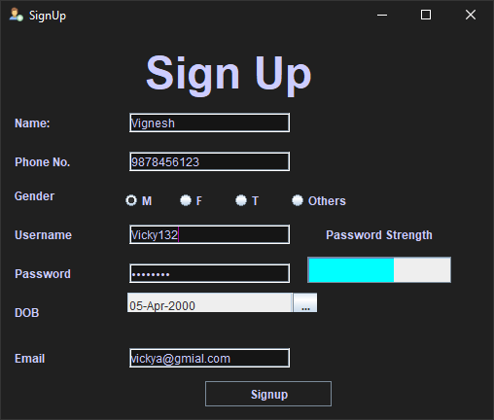
Sign Up

Slide 11
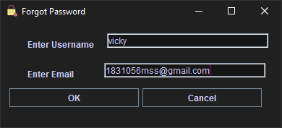
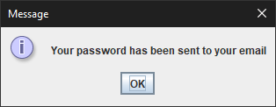
Forgot Password

Slide 12
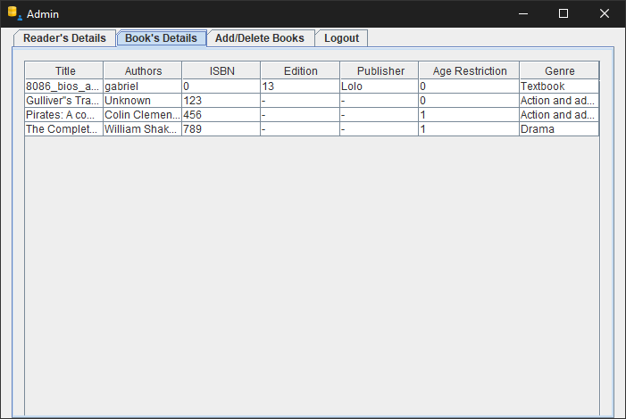
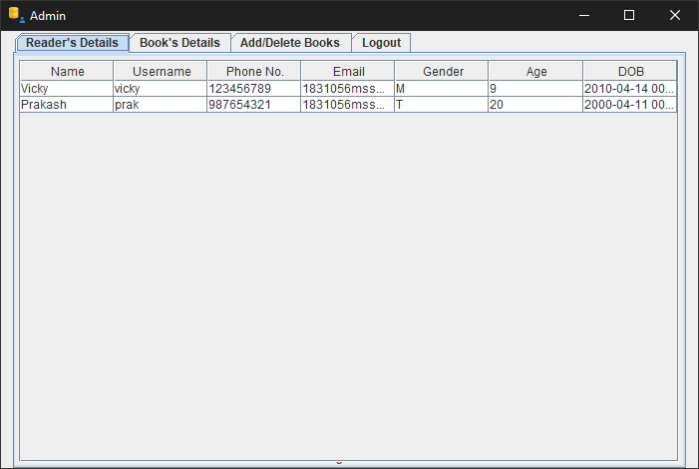
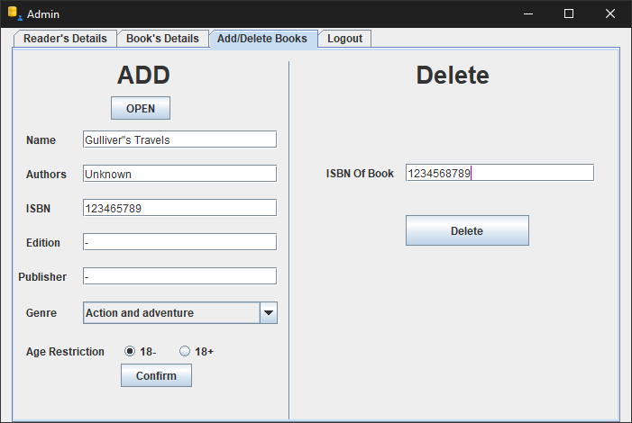
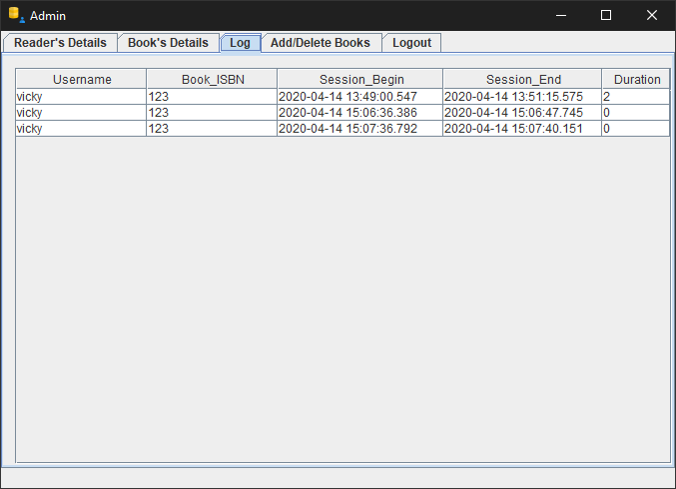
Administrator

Slide 13
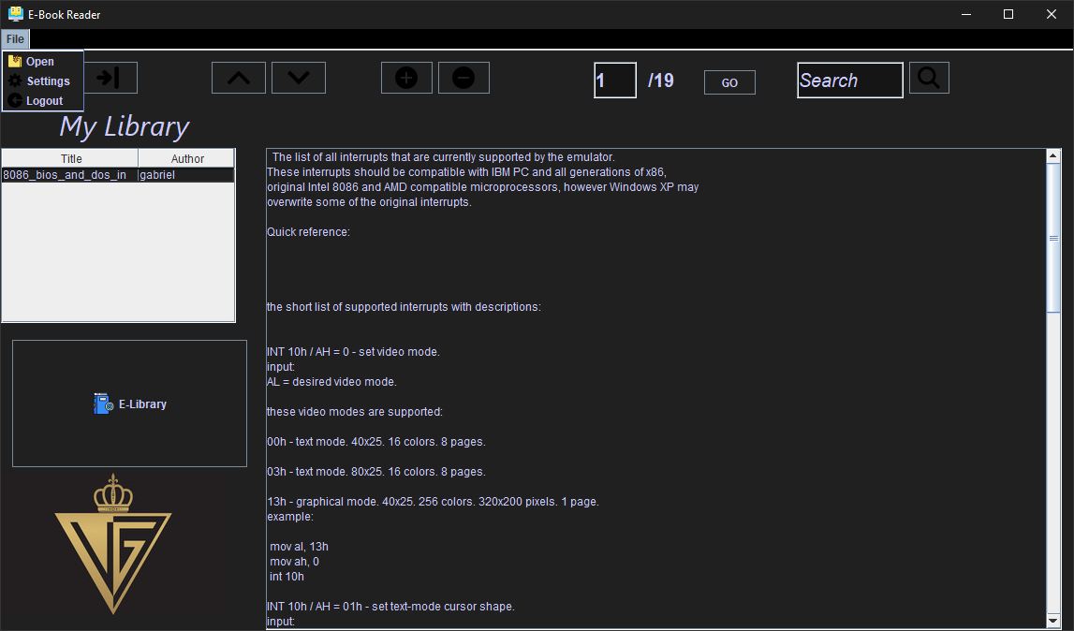
eBook Reader

Slide 14
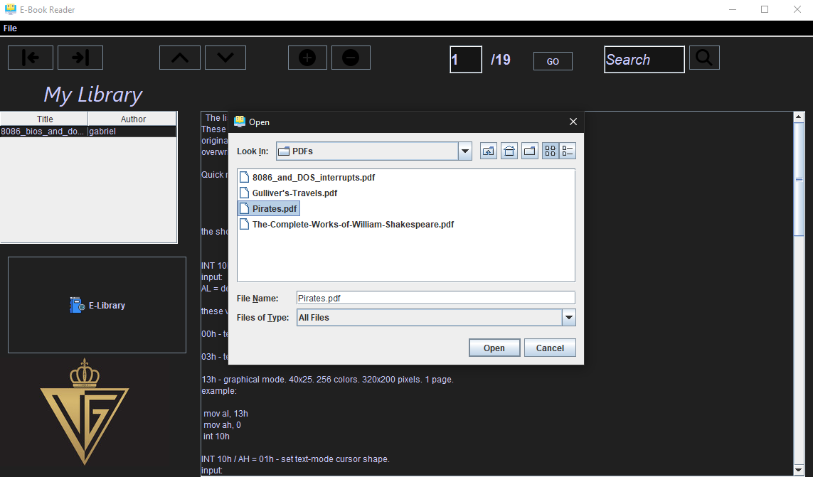
Opening Books From local Machine

Slide 15
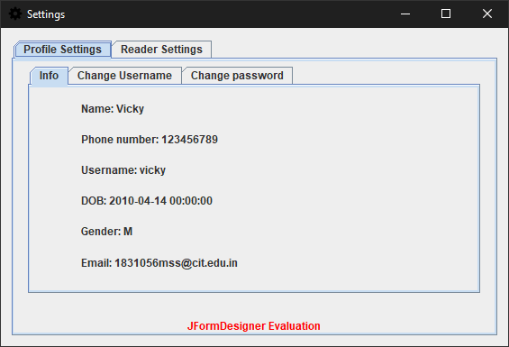
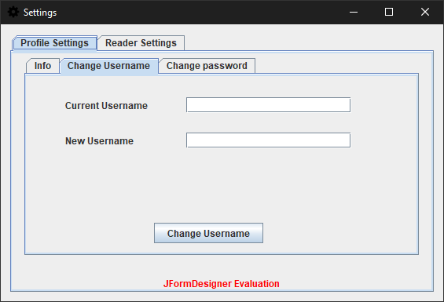
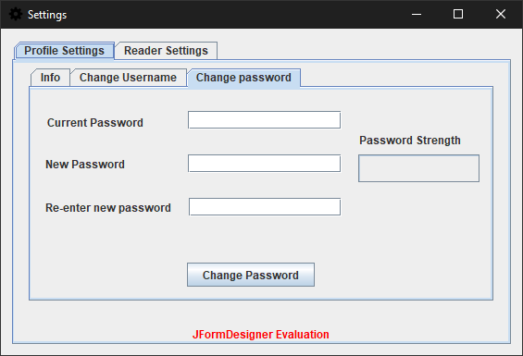
Profile Settings

Slide 16
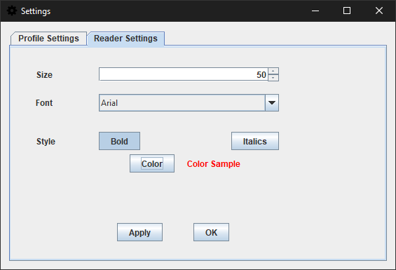
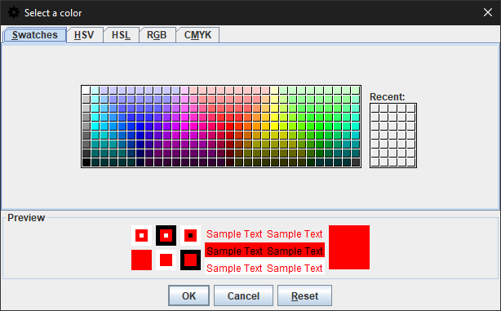
E-Book Reader Settings

Slide 17
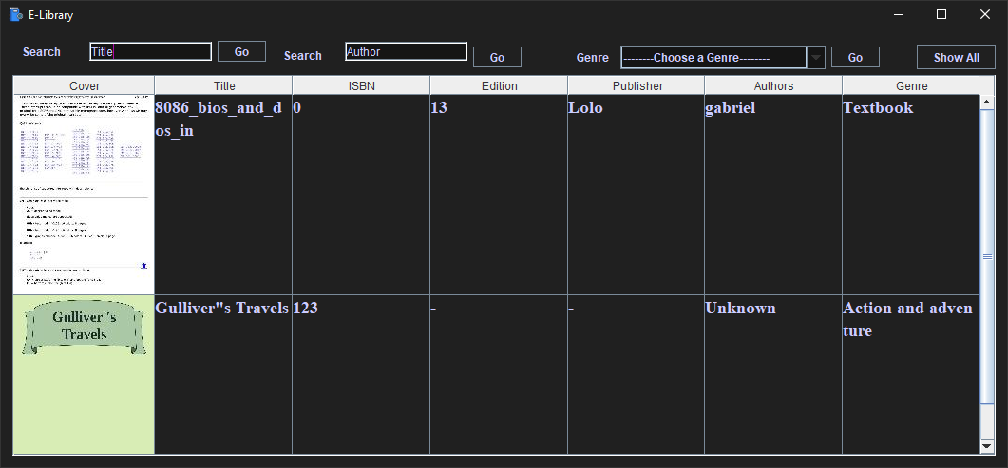
E-Library

Slide 18
Back-end Code

Slide 19
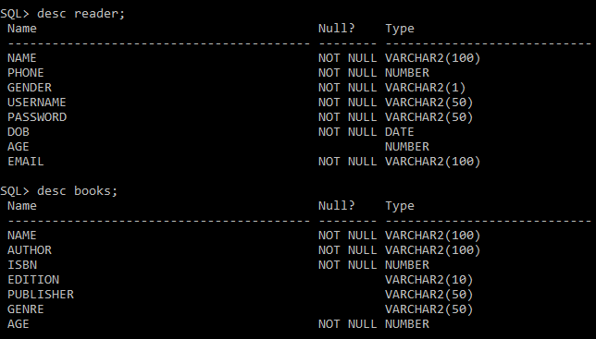
Created Table

Slide 20
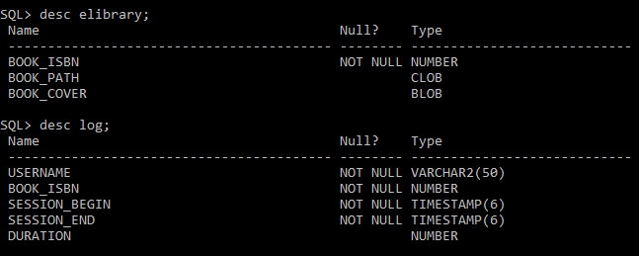
Created Table cont.…

Slide 21
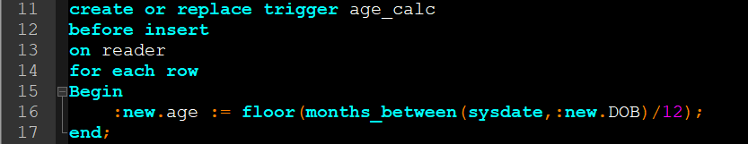
Age Calculation Trigger
Foreign Key Constraint

Slide 22
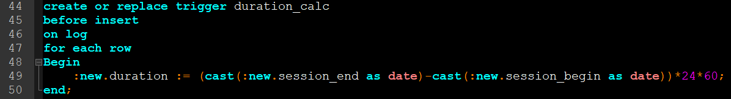
Duration Calculation Trigger

Slide 23
Login
Class.forName("oracle.jdbc.driver.OracleDriver"); Connection con = DriverManager.getConnection("jdbc:oracle:thin:@localhost:1521:orcl", "system", "123456789"); PreparedStatement cmd = con.prepareStatement("select * from reader where username = ?"); cmd.setString(1, textField1.getText()); ResultSet rs = cmd.executeQuery(); if (rs.next()) { // username does exist, now check the password if (rs.getString("password").equals(String.valueOf(passwordField1.getPassword()))) { name = rs.getString("name"); phone = rs.getInt("phone"); gender = rs.getString("gender"); username = rs.getString("username"); dob = rs.getString("dob"); email = rs.getString("email"); password = rs.getString("password"); age = rs.getInt("age"); this.setVisible(false); new Reader(this).setVisible(true); this.dispose(); } else { JOptionPane.showMessageDialog(null, "Please check your password!!"); } } else { // username does not exist JOptionPane.showMessageDialog(null, "Please check your username!!"); }

Slide 24
Adding new user code
Class.forName("oracle.jdbc.driver.OracleDriver"); Connection con = DriverManager.getConnection("jdbc:oracle:thin:@localhost:1521:orcl", "system", "123456789"); Statement stmt = con.createStatement(); String name = textField1.getText(); String phone = textField2.getText(); String user = textField3.getText(); String pass = String.valueOf(passwordField1.getPassword()); String email = textField6.getText(); String gen = null; if(radioButton1.isSelected()){ gen = "M"; } else if(radioButton2.isSelected()){ gen = "F"; } else if(radioButton3.isSelected()){ gen = "T"; } else if(radioButton3.isSelected()){ gen = "O"; }
String insert_query = "insert into reader" + " (name, phone, gender,username,password,dob,email)" + " values (?, ?, ?, ?, ?, ?, ?)"; PreparedStatement preSt = con.prepareStatement(insert_query); preSt.setString(1, name); preSt.setString(2, phone); preSt.setString(3, gen); preSt.setString(4, user); preSt.setString(5, pass); preSt.setString(6, reportDate); preSt.setString(7, email); preSt.executeUpdate(); con.close();

Slide 25
View Reader/Book Records
Class.forName("oracle.jdbc.driver.OracleDriver"); Connection con = DriverManager.getConnection("jdbc:oracle:thin:@localhost:1521:orcl", "system", "123456789"); Statement stmt = con.createStatement(); String query = "select * from reader"; ResultSet rs = stmt.executeQuery(query); while (rs.next()) { DefaultTableModel model = (DefaultTableModel) table1.getModel(); Object[] row = {rs.getString("name"), rs.getString("username"), String.valueOf(rs.getInt("phone")), rs.getString("email"), rs.getString("gender"), String.valueOf(rs.getInt("age")), rs.getString("dob")}; model.addRow(row); } con.close();
Class.forName("oracle.jdbc.driver.OracleDriver"); Connection con = DriverManager.getConnection("jdbc:oracle:thin:@localhost:1521:orcl", "system", "123456789"); Statement stmt = con.createStatement(); String query = "select * from books"; ResultSet rs = stmt.executeQuery(query); while (rs.next()) { DefaultTableModel model = (DefaultTableModel) table2.getModel(); Object[] row = {rs.getString("name"), rs.getString("author"), String.valueOf(rs.getInt("isbn")), rs.getString("edition"), rs.getString("publisher"), String.valueOf(rs.getInt("age")), rs.getString("genre")}; model.addRow(row); } con.close();

Slide 26
View Log
Class.forName("oracle.jdbc.driver.OracleDriver"); Connection con = DriverManager.getConnection("jdbc:oracle:thin:@localhost:1521:orcl", "system", "123456789"); Statement stmt = con.createStatement(); String query = "select * from log"; ResultSet rs = stmt.executeQuery(query); while (rs.next()) { DefaultTableModel model = (DefaultTableModel) table3.getModel(); Object[] row = {rs.getString("username"), rs.getInt("book_isbn"),
rs.getTimestamp("session_begin"), rs.getTimestamp("session_end"),rs.getInt("duration")}; model.addRow(row); } con.close();

Slide 27
ADD book to Database
imgPath = "C:\\Users\\Vicky\\Documents\\Java\\EBook_Reader\\covers\\" + textField3.getText() + ".jpeg"; ImageIO.write(image, "JPEG", new File(imgPath)); if (radioButton1.isSelected()) {age = 0;} if (radioButton2.isSelected()) {age = 1;} Class.forName("oracle.jdbc.driver.OracleDriver"); Connection con = DriverManager.getConnection("jdbc:oracle:thin:@localhost:1521:orcl", "system", "123456789"); Statement stmt = con.createStatement(); String insert_query = "insert into books“ + " values (?, ?, ?, ?, ?, ? ,?)"; PreparedStatement preSt = con.prepareStatement(insert_query); preSt.setString(1, textField1.getText()); preSt.setString(2, textField2.getText()); preSt.setString(3, textField3.getText()); preSt.setString(4, textField4.getText()); preSt.setString(5, textField5.getText()); preSt.setString(6, comboBox1.getItemAt(comboBox1.getSelectedIndex())); preSt.setInt(7, age); preSt.executeUpdate(); con.close(); if (uploadLibrary()) { JOptionPane.showMessageDialog(null, "Book successfully uploaded!"); textField1.setText(""); textField2.setText(""); textField3.setText(""); textField4.setText(""); textField5.setText(""); comboBox1.setSelectedIndex(0); filePath = null; imgPath = null; }

Slide 28
ADD book to Database cont..
StringReader reader = new StringReader(filePath); Class.forName("oracle.jdbc.driver.OracleDriver"); Connection con=DriverManager.getConnection("jdbc:oracle:thin:@localhost:1521:orcl","system","123456789"); PreparedStatement ps=con.prepareStatement("insert into elibrary values(?,?,?)"); ps.setString(1,textField3.getText()); ps.setClob(2,reader); { File inputFile = new File(imgPath); BufferedImage inputImage = ImageIO.read(inputFile); // creates output image BufferedImage outputImage = new BufferedImage(149, 211, inputImage.getType()); // scales the input image to the output image Graphics2D g2d = outputImage.createGraphics(); g2d.drawImage(inputImage, 0, 0, 149, 211, null); g2d.dispose(); // extracts extension of output file String formatName = imgPath.substring(imgPath.lastIndexOf(".") + 1); // writes to output file ImageIO.write(outputImage, formatName, new File(imgPath)); } FileInputStream fin=new FileInputStream(imgPath); ps.setBinaryStream(3,fin,fin.available()); ps.executeUpdate(); con.close(); return true;

Slide 29
Delete book from Database
Class.forName("oracle.jdbc.driver.OracleDriver"); Connection con = DriverManager.getConnection("jdbc:oracle:thin:@localhost:1521:orcl", "system", "123456789"); Statement stmt = con.createStatement(); String query = "delete from books where isbn='"+textField7.getText()+"'"; int deleted = stmt.executeUpdate(query); if(deleted == 0){ JOptionPane.showMessageDialog(null,"ISBN does not exist!" ); } else{ JOptionPane.showMessageDialog(null,"Book has been deleted successfully!" ); } CardLayout layout = (CardLayout) panel7.getLayout(); layout.show(panel7, "card1"); textField7.setText("");

Slide 30
Display Books in E-Library From Database
Class.forName("oracle.jdbc.driver.OracleDriver"); Connection con = DriverManager.getConnection("jdbc:oracle:thin:@localhost:1521:orcl", "system", "123456789"); Statement stmt1 = con.createStatement();Statement stmt2 = con.createStatement(); String query1 = "select * from books"; ResultSet rs1 = stmt1.executeQuery(query1); while (rs1.next()) { if (a == rs1.getInt("age")) { DefaultTableModel model = (DefaultTableModel) table1.getModel(); int isbn = rs1.getInt("isbn"); String query2 = "select * from elibrary where book_isbn='" + isbn + "'"; ResultSet rs2 = stmt2.executeQuery(query2); if (rs2.next()) { Clob clob = rs2.getClob("book_path"); r = clob.getCharacterStream(); buffer = new StringBuffer();int ch; while ((ch = r.read()) != -1) {buffer.append("" + (char) ch);} Blob b = rs2.getBlob(3); byte barr[] = b.getBytes(1, (int) b.length()); FileOutputStream fOut = new FileOutputStream("C:\\Users\\Vicky\\Documents\\Java\\EBook_Reader\\ecovers\\" + isbn + ".jpeg"); fOut.write(barr); fOut.close(); } rs2.close(); ImageIcon cover = new ImageIcon("C:\\Users\\Vicky\\Documents\\Java\\EBook_Reader\\ecovers\\" + isbn + ".jpeg"); Object[] row = {cover, rs1.getString("name"), String.valueOf(rs1.getInt("isbn")), rs1.getString("edition"), rs1.getString("publisher"), String.valueOf(rs1.getString("Author")), rs1.getString("genre"), buffer.toString()}; model.addRow(row);
}
}

Slide 31
Update Log
try { User.se = new Timestamp(new Date().getTime()); } catch (Exception ee){System.out.print(ee);} if(User.isbn!=0) { try { User.se = new Timestamp(new Date().getTime()); Class.forName("oracle.jdbc.driver.OracleDriver"); Connection con = DriverManager.getConnection("jdbc:oracle:thin:@localhost:1521:orcl", "system", "123456789"); Statement stmt = con.createStatement(); String insert_query = "insert into log" + " (username, book_isbn, session_begin,session_end)" + " values (?, ?, ?, ?)"; PreparedStatement ps = con.prepareStatement(insert_query); ps.setString(1,User.username); ps.setInt(2,User.isbn); ps.setTimestamp(3,User.sb); ps.setTimestamp(4,User.se); ps.executeUpdate(); con.close(); } catch (Exception ee) { System.out.print(ee); } }

Slide 32
Thank you

